Slide 1
MEMENTO PATTERN
USED CAR DEALERSHIP
By MOHAMMAD ARIZ HAIDER

Slide 2
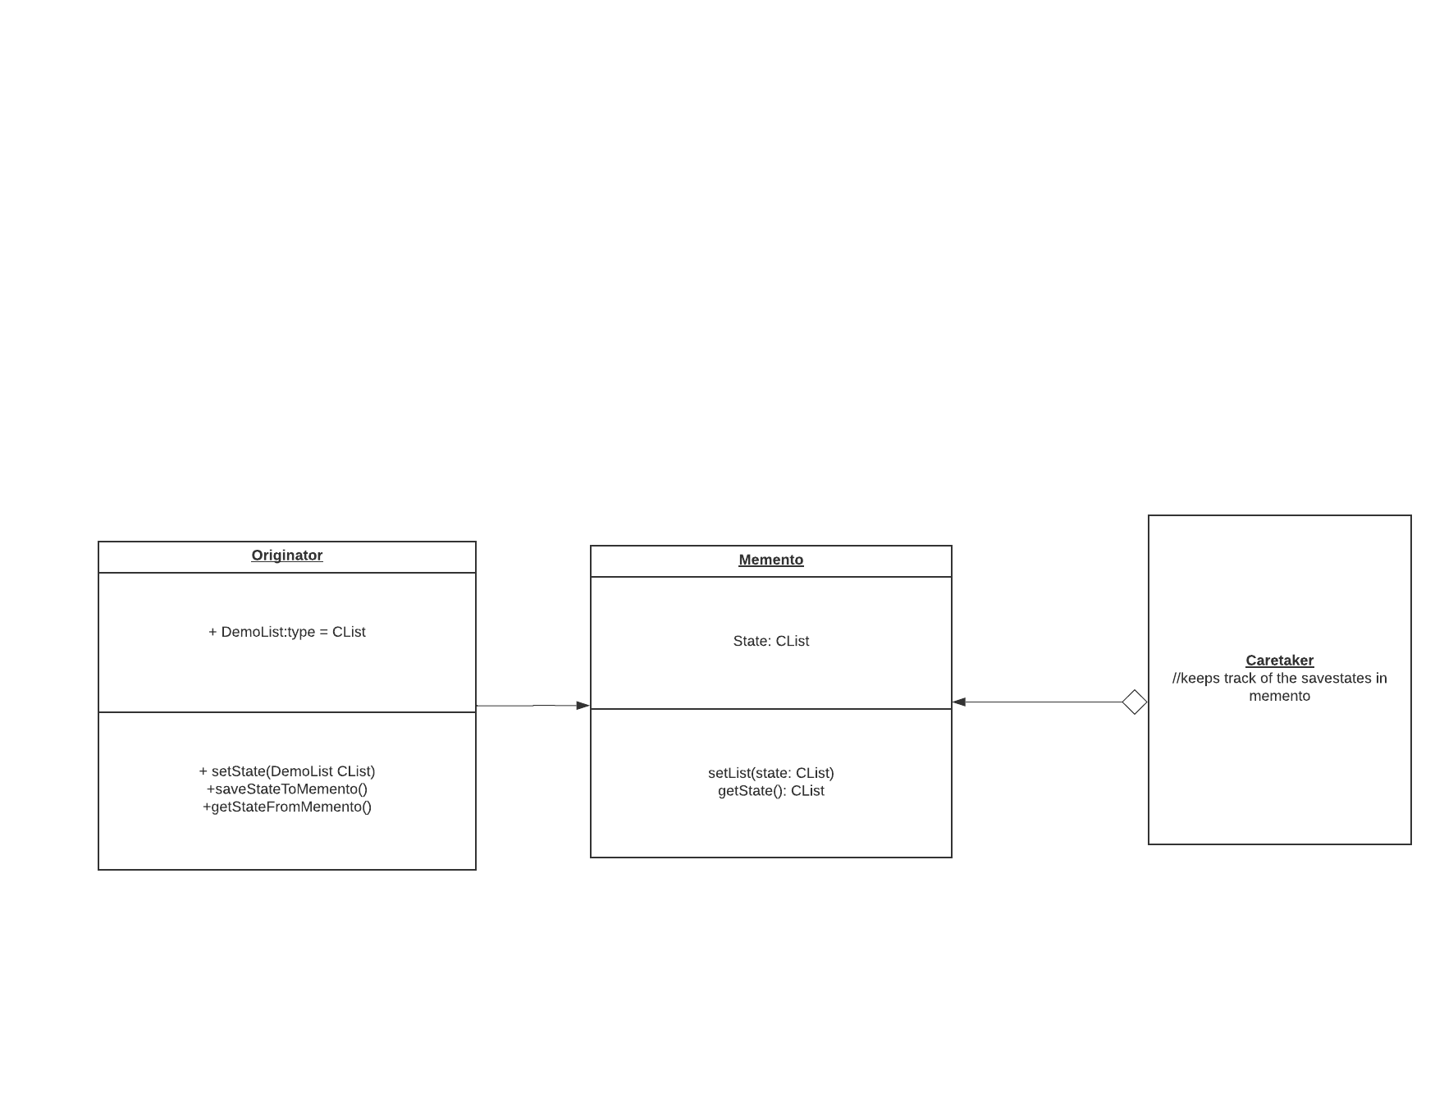
MEMENTO PATTERN: UML

Slide 3
Features of Memento
01
Able to save the state of an object in one or in as many states (checkpoints) as required
02
Able to restore the object back to a previous state, if any mistakes were made or i original state was required

Slide 4
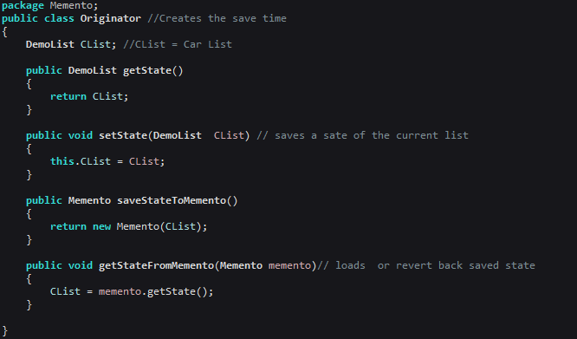
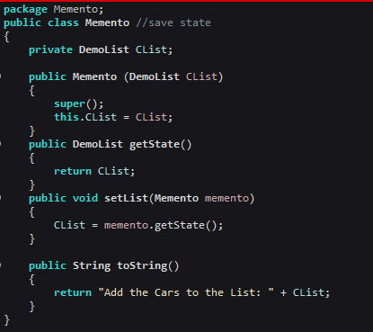
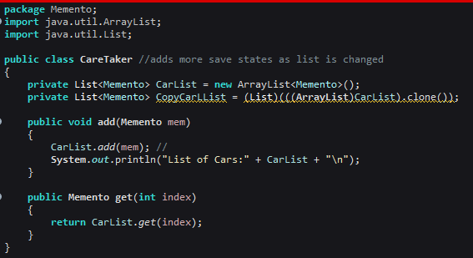


3 Key things the Client needs to know
2. This is where the states of the object are kept,
3. CareTaker keeps track of how many states are saved in Memento. It also used for reloading a previously saved state, which was saved by the Originator
Originator saves the default state of the object, in this case, CList (Car List) to Memento

Slide 5
Component Testing
A list of cars exist for the user to buy (gets removed from the list) and sell, (gets added to the car list). The List is first a default state (untouched) which exists in the Originator, it then is saved as a Memento (Save File), and the CareTaker keeps track of how many different save files are added or removed (keeps track of states). If a car is bought by accident and the list must be return to previous state, the CareTaker takes the saved state in the Memento which has the index no. of state before purchase and restores the list to that state.

